Slide 1
Introducing Information Retrieval
and Web Search

Slide 2
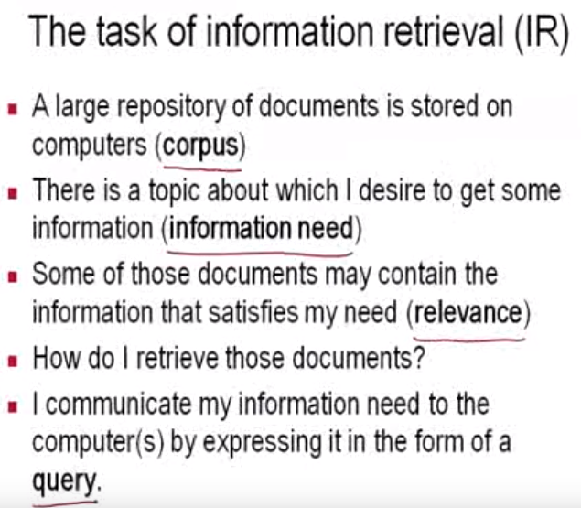
Information Retrieval

Slide 3
Information Retrieval
Information Retrieval (IR) is finding material (usually documents) of an unstructured nature (usually text) that satisfies an information need from within large collections (usually stored on computers).
  These days we frequently think first of web search, but there are many other cases:
    E-mail search
    Searching your laptop
    Corporate knowledge bases
    Legal information retrieval

Slide 4
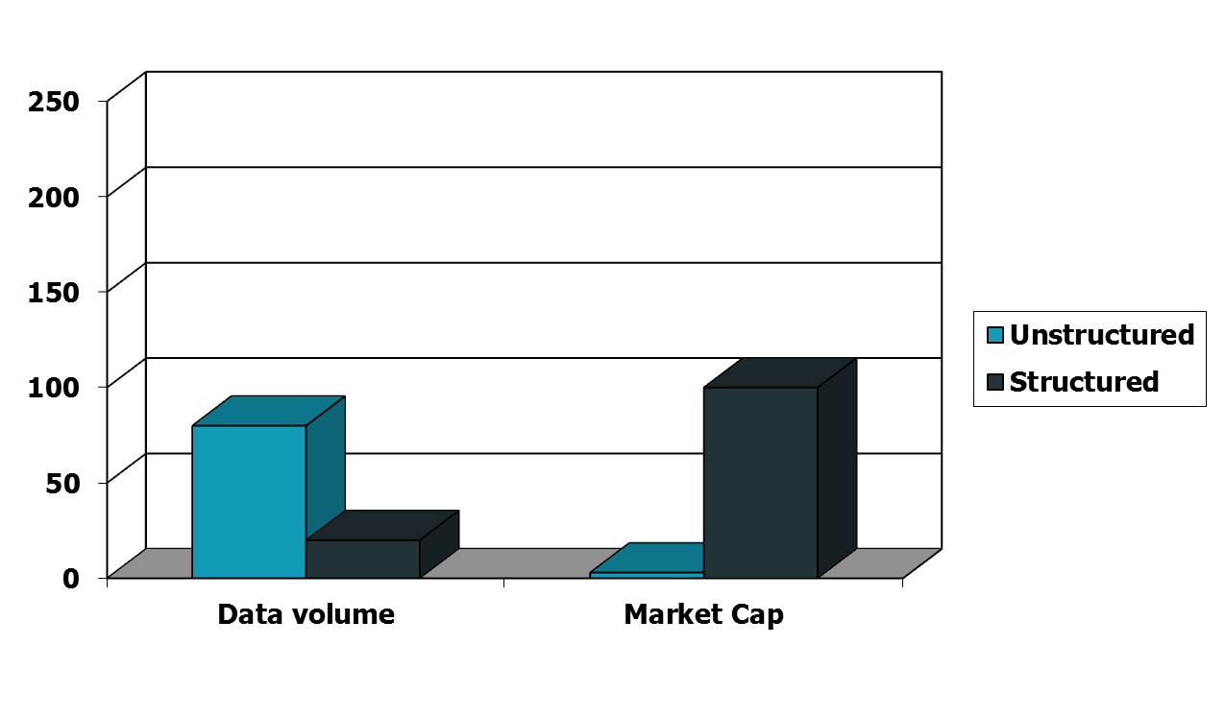
Unstructured (text) vs. structured (database) data in the mid-nineties

Slide 5
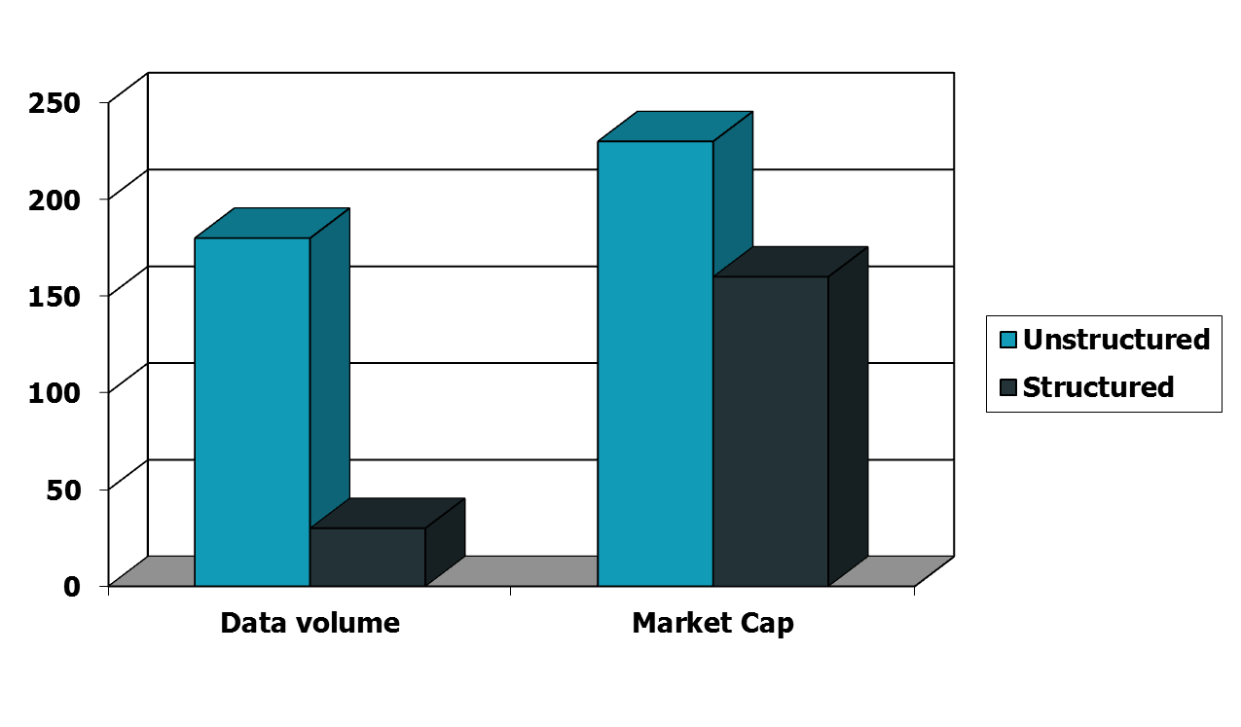
Unstructured (text) vs. structured (database) data today
Notes:
To the surprise of many, the search box has become the preferred method of information access.
Customers ask: Why can’t I search my database in the same way?

Slide 6
Basic assumptions of Information Retrieval
Sec. 1.1
Collection: A set of documents
  Assume it is a static collection for the moment
Goal: Retrieve documents with information that is relevant to the user’s information need and helps the user complete a task

Slide 7
The classic search model
User task
Get rid of mice in a politically correct way
Misconception?
Info need
Info about removing mice
without killing them
Misformulation?
Query
how trap mice alive
Search
Search
engine
Query
refinement
Results
Collection

Slide 8
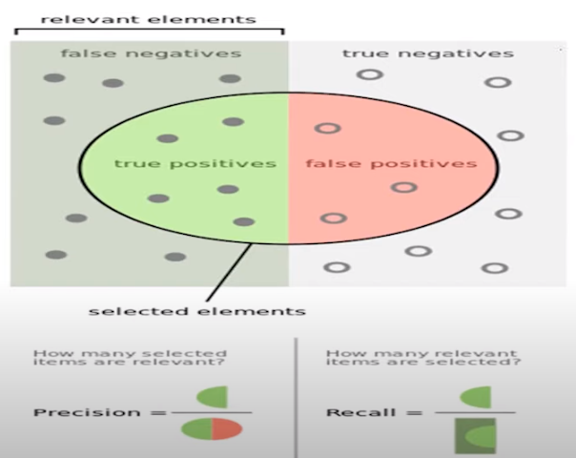
How good are the retrieved docs?
Sec. 1.1
Precision : Fraction of retrieved docs that are relevant to the user’s information need
Recall : Fraction of relevant docs in collection that are retrieved
Right or wrong/retrieved or not

Slide 9
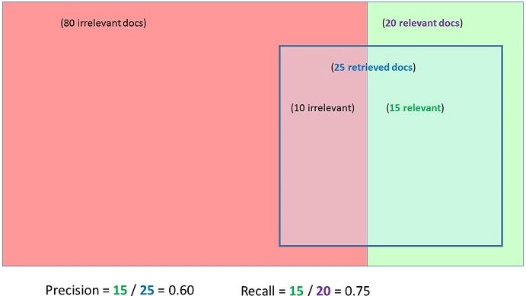
How good are the retrieved docs?
Sec. 1.1
Precision : Fraction of retrieved docs that are relevant to the user’s information need
Recall : Fraction of relevant docs in collection that are retrieved
Search Word:”ford

Slide 10
Term-document incidence matrices

Slide 11
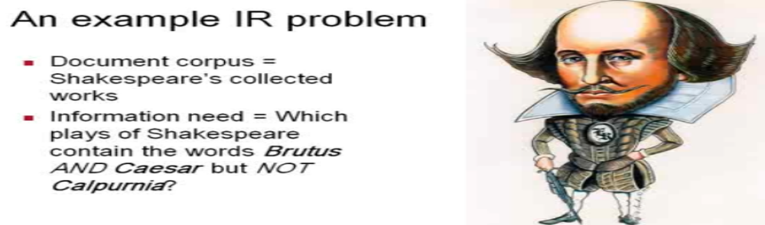
Unstructured data in 1620
Sec. 1.1
One could grep all of Shakespeare’s plays for Brutus and Caesar, then lines containing Calpurnia?
Why is that not the answer?
  Slow (for large corpora)
  Roman near countrymen is not trival (position of terms)
  Repeat linear scan with each query(too long time)
  Ranked retrieval (best documents to return(the no each word repeated in doc)
Notes:
Grep is line-oriented; IR is document oriented.

Slide 12
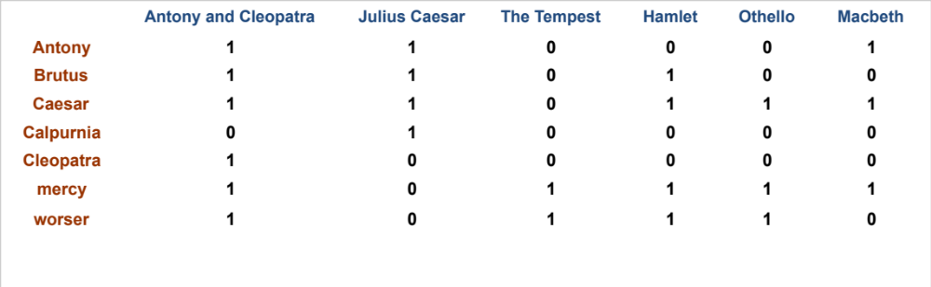
Term-document incidence matrices
Sec. 1.1
1 if play contains word, 0 otherwise
Brutus AND Caesar BUT NOT Calpurnia

Slide 13

Incidence vectors
Sec. 1.1
So we have a 0/1 vector for each term.
To answer query: take the vectors for Brutus, Caesar and Calpurnia (complemented) ➔ bitwise AND.
  110100 AND
  110111 AND
  101111 =
  100100

Slide 14
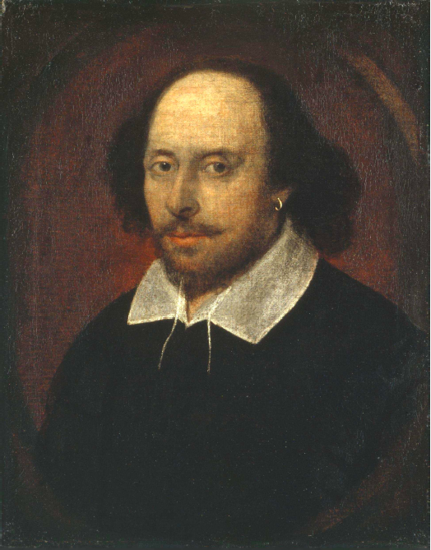
Answers to query
Sec. 1.1
Antony and Cleopatra, Act III, Scene ii
Agrippa [Aside to DOMITIUS ENOBARBUS]: Why, Enobarbus,
When Antony found Julius Caesar dead,
He cried almost to roaring; and he wept
When at Philippi he found Brutus slain.
Hamlet, Act III, Scene ii
Lord Polonius: I did enact Julius Caesar I was killed i’ the
Capitol; Brutus killed me.
Notes:
Wikimedia commons picture of Shake

Slide 15
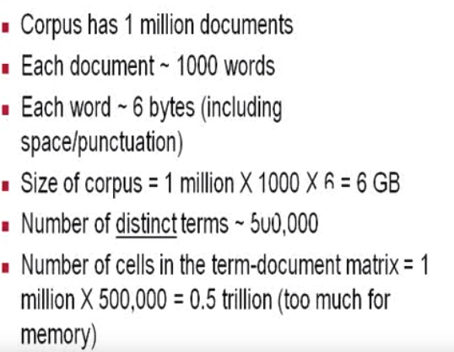
Bigger collections
Sec. 1.1

Slide 16
Can’t build the matrix
Sec. 1.1
500K x 1M matrix has half-a-trillion 0’s and 1’s.
But it has no more than one billion 1’s
(1000*1million).
  matrix is extremely sparse (“most of entries are 0” 99.8%).
What’s a better representation?
  We only record the 1 positions.
Total cell in matrix=0.5*10¹²
Why?

Slide 17
The Inverted Index
The key data structure underlying modern IR

Slide 18
Inverted index
Sec. 1.2
For each term t, we must store a list of all documents that contain t.
  Identify each doc by a docID, a document serial number
Can we used fixed-size arrays for this?
Brutus
1
2
4
11
31
45
173
174
Caesar
1
2
4
5
6
16
57
132
Calpurnia
2
31
54
101
What happens if the word Caesar is added to document 14?

Slide 19
Inverted index
Sec. 1.2
We need variable-size postings lists
  On disk, a continuous run of postings is normal and best
  In memory, can use linked lists or variable length arrays
    Some tradeoffs in size/ease of insertion
Posting
Brutus
1
2
4
11
31
45
173
174
Caesar
1
2
4
5
6
16
57
132
Calpurnia
2
31
54
101
Dictionary
Postings
Sorted by docID (more later on why).
Notes:
Linked lists generally preferred to arrays
Dynamic space allocation
Insertion of terms into documents easy
Space overhead of pointers

Slide 20

Inverted index construction
Sec. 1.2
Documents to
be indexed
Friends, Romans, countrymen.
Tokenizer
Token stream
Friends
Romans
Countrymen
Linguistic modules
Modified tokens
friend
roman
countryman
Indexer
friend
2
4
roman
1
2
Inverted index
countryman
13
16
Notes:
Document icons from free icon set: http://www.icojoy.com/articles/44/

Slide 21
Initial stages of text processing
Tokenization
  Cut character sequence into word tokens
    Deal with “John’s”, a state-of-the-art solution
Normalization
  Map text and query term to same form
    You want U.S.A. and USA to match
Stemming
  We may wish different forms of a root to match
    authorize, authorization
Stop words
  We may omit very common words (or not)
    the, a, to, of

Slide 22

Indexer steps: Token sequence
Sec. 1.2
Sequence of (Modified token, Document ID) pairs.
Doc 1
Doc 2
I did enact Julius
Caesar I was killed
i’ the Capitol;
Brutus killed me.
So let it be with
Caesar. The noble
Brutus hath told you
Caesar was ambitious

Slide 23

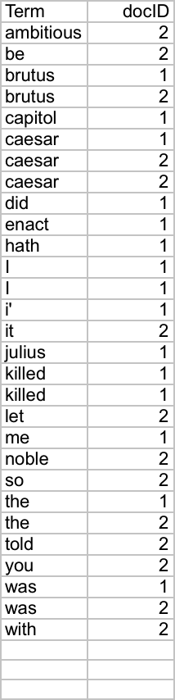
Indexer steps: Sort
Sec. 1.2
Sort by terms
  And then docID
Core indexing step

Slide 24

Indexer steps: Dictionary & Postings
Sec. 1.2
Multiple term entries in a single document are merged.
Split into Dictionary and Postings
Doc. frequency information is added.

Slide 25
Where do we pay in storage?
Sec. 1.2
Lists of docIDs
Terms and counts
IR system implementation
How do we index efficiently?
How much storage do we need?
Pointers

Slide 26
Query processing with an inverted index

Slide 27
The index we just built
Sec. 1.3
How do we process a query?
  Later - what kinds of queries can we process?
Our focus

Slide 28
Query processing: AND
Sec. 1.3
Consider processing the query:
  Brutus AND Caesar
  Locate Brutus in the Dictionary;
    Retrieve its postings.
  Locate Caesar in the Dictionary;
    Retrieve its postings.
  “Merge” the two postings (intersect the document sets):
2
4
8
16
32
64
128
Brutus
1
2
3
5
8
13
21
34
Caesar

Slide 29

Intersecting two postings lists
(a “merge” algorithm)

Slide 30
The merge
Sec. 1.3
Walk through the two postings simultaneously, in time linear in the total number of postings entries
2
4
8
16
32
64
128
Brutus
1
2
3
5
8
13
21
34
Caesar

Slide 31
Quiz
When a search engine returns 30 pages only 20 of which were relevant while failing to return 40 additional relevant pages, its precision =……………. while its recall =…………………….

Slide 32
The Boolean Retrieval Model
& Extended Boolean Models

Slide 33
Phrase queries
Sec. 2.4
We want to be able to answer queries such as “stanford university” – as a phrase
Thus the sentence “I went to university at Stanford” is not a match.
  The concept of phrase queries has proven easily understood by users; one of the few “advanced search” ideas that works
For this, it no longer suffices to store only
<term : docs> entries

Slide 34
A first attempt: Biword indexes
Sec. 2.4.1
Index every consecutive pair of terms in the text as a phrase
For example the text “Friends, Romans, Countrymen” would generate the biwords
  friends romans
  romans countrymen
Each of these biwords is now a dictionary term
Two-word phrase query-processing is now immediate.

Slide 35
Longer phrase queries
Sec. 2.4.1
Longer phrases can be processed by breaking them down
stanford university palo alto can be broken into the Boolean query on biwords:
stanford university AND university palo AND palo alto
Although its find in a doc but indifferent places ”not as the pharse”
1-find documents for each biwords
2-get the intersection between them
Can have false positives!

Slide 36
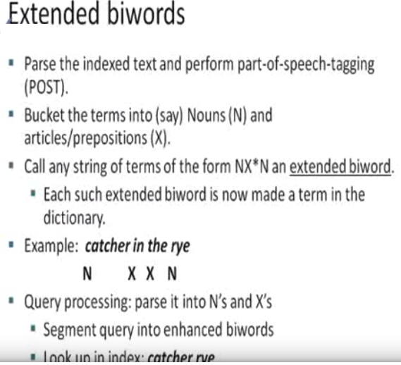
Most of queries are nouns
Search for nouns in each document

Slide 37
Issues for biword indexes
Sec. 2.4.1
False positives, as noted before
Index blowup due to bigger dictionary
  Infeasible for more than biwords, big even for them (hard for memory)
Biword indexes are not the standard solution (for all biwords) but can be part of a compound strategy(popular phrases only to save retrieving time )
Biwords for a phrase can be find in same doc but not near to each other

Slide 38
Solution 2: Positional indexes
Sec. 2.4.2
In the postings, store, for each term the position(s) in which tokens of it appear:
  <term, number of docs containing term;
  doc1: position1, position2 … ;
  doc2: position1, position2 … ;
  etc.>

Slide 39
Positional index example
Sec. 2.4.2
<be: 993427;
1: 7, 18, 33, 72, 86, 231;
2: 3, 149;
4: 17, 191, 291, 430, 434;
5: 363, 367, …>
Which of docs 1,2,4,5
could contain “to be
or not to be”?
For biword phrase queries, we use a merge algorithm(phrase in query with dictionary) recursively at the document level
But we now need to deal with more than just equality

Slide 40
Processing a phrase query
Sec. 2.4.2
Extract inverted index entries for each distinct term: to, be, or, not.
Merge their doc:position lists to enumerate all positions with “to be or not to be”.
  to:
    2:1,17,74,222,551; 4:8,16,190,429,433; 7:13,23,191; ...
  be:
    1:17,19; 4:17,191,291,430,434; 5:14,19,101; ...

Slide 41
Positional index size
Sec. 2.4.2
Need an entry for each occurrence, not just once per document
Index size depends on average document size
  Average web page has <1000 terms
  SEC filings, books, even some epic poems … easily 100,000 terms
Consider a term with frequency 0.1%
Why?
Document size
Postings
Positional postings
1000
1
1
100,000
1
100

Slide 42
Rules of thumb
Sec. 2.4.2
A positional index is 2–4 as large as a non-positional index
Positional index size 35–50% of volume of original text (disk space)
  Caveat: all of this holds for “English-like” languages

Slide 43
Combination schemes
Sec. 2.4.3
These two approaches can be profitably combined
  For particular phrases (“Michael Jackson”, “Britney Spears”) it is inefficient to keep on merging positional postings lists (popular biwords)
    Even more so for phrases like “The Who”(intersection will be very expensive in positional index(large posting lists)
    Williams et al. (2004) evaluate a more sophisticated mixed indexing scheme
  A typical web query mixture was executed in ¼ of the time of using just a positional index
  It required 26% more space than having a positional index alone

Slide 44
Structured vs. Unstructured Data

Slide 45
Query optimization
Sec. 1.3
What is the best order for query processing?
Consider a query that is an AND of n terms.
For each of the n terms, get its postings, then AND them together.
Brutus
2
4
8
16
32
64
128
Caesar
1
2
3
5
8
16
21
34
Calpurnia
13
16
Query: Brutus AND Calpurnia AND Caesar

Slide 46
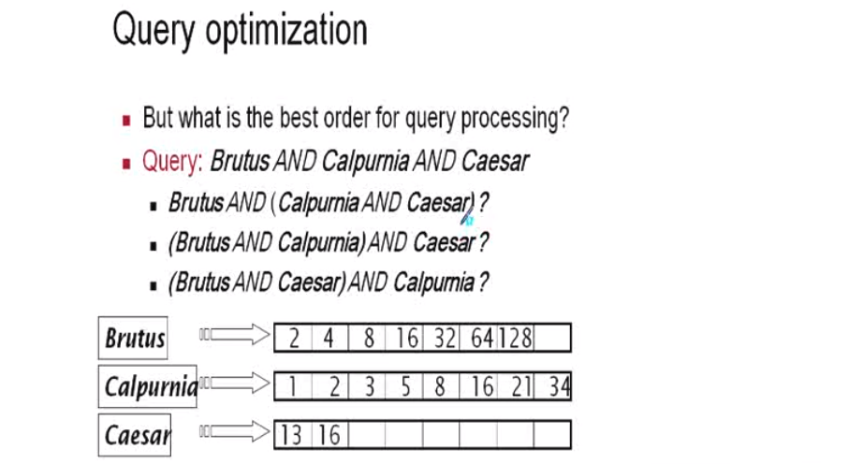

Slide 47
Query optimization example
Sec. 1.3
Process in order of increasing freq:
  start with smallest set, then keep cutting further.
This is why we kept
document freq. in dictionary
Brutus
2
4
8
16
32
64
128
Caesar
1
2
3
5
8
16
21
34
Calpurnia
13
16
Execute the query as (Calpurnia AND Brutus) AND Caesar.

Slide 48
More general optimization
Sec. 1.3
e.g., (madding OR crowd) AND (ignoble OR strife)
Get doc. freq.’s for all terms.
Estimate the size of each OR by the sum of its doc. freq.’s (conservative).
Process in increasing order of OR sizes.

Slide 49
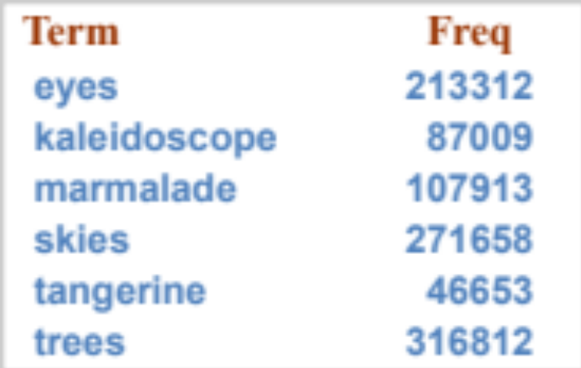
Exercise
Recommend a query processing order for
Which two terms should we process first?
(tangerine OR trees) AND
(marmalade OR skies) AND
(kaleidoscope OR eyes)
300321 (1)
379571 (3)
363465 (2)

Slide 50
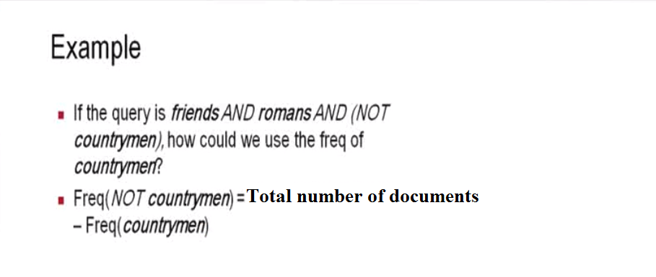

Slide 51
Structured vs. Unstructured Data

Slide 52
IR vs. databases:
Structured vs unstructured data
Structured data tends to refer to information in “tables”
Employee
Manager
Salary
Smith
Jones
50000
Chang
Smith
60000
Ivy
Smith
50000
Typically allows numerical range and exact match
(for text) queries, e.g.,
Salary < 60000 AND Manager = Smith.

Slide 53
Unstructured data
Typically refers to free text
Allows
  Keyword queries including operators
  More sophisticated “concept” queries e.g.,
    find all web pages dealing with drug abuse
Classic model for searching text documents

Slide 54
Semi-structured data
In fact almost no data is “unstructured”
E.g., this slide has distinctly identified zones such as the Title and Bullets
    … to say nothing of linguistic structure
Facilitates “semi-structured” search such as
  Title contains data AND Bullets contain search
Or even
  Title is about Object Oriented Programming AND Author something like stro*rup
  where * is the wild-card operator

